Slide 1
Heart diseases prediction system using classification and genetic algorithm
Authors: Snehal Mandavkar
Priyanka Shinde
Anshka Jagdale
Prof. Vijaya Pinjarkar
Affiliation: Somaiya University/ IT Department, India

Slide 2
Introduction
Coronary disease or cardiovascular disease (CVD), which stays the main reason of death around the world and adds to roughly 30% of worldwide mortality rates. If this issue is unattended then the projected mortality rate could be as high around 22 million in 20a30.
The developing countries such as India is also having severe threat on this disease.
It takes severe mortality rate of around 17 million persons, as per report every year. Coronary disease may cause the or obstruct the flow of blood through blood vessel and may cause heart failure or even a stoke.
Early diagnosis of the disease can save lives and medical diagnosis plays key role. the practitioners are applying many advance treatments.
Data mining techniques like classifications are highly useful in machine learning domain, in which clinical decision making can be arrived accurately.
This machine learning predictions can improve in quick decision making and decreasing the danger of heart failure ranging from failure to stroke with appropriate treatments.

Slide 3
Research Question
R1: How we can Create the awareness of heart disease among the vulnerable and underprivileged sections of the population.
R2: How can we encourage the application of Heart Disease knowledge in general health care and in social development.
R3: How can we provide better performance and accuracy than existing system.
R4:How we can able to make a platform where patient can get treatment

Slide 4
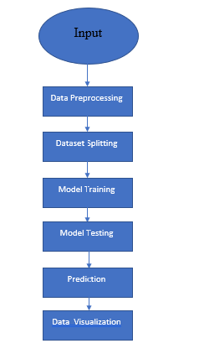
Methodology
Steps:
1.Data Collection
2.Data Pre-processing
3. Dataset splitting
4. Model training
5. Model evaluation and testing
6.Prediction
7. Data visualization

Slide 5
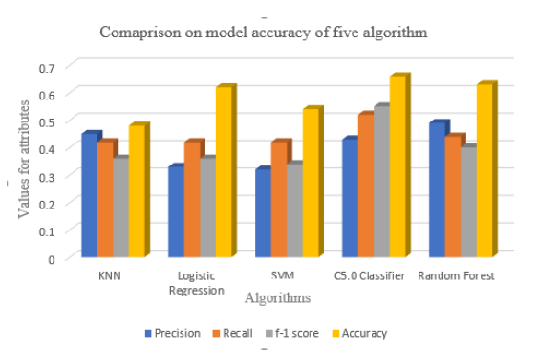
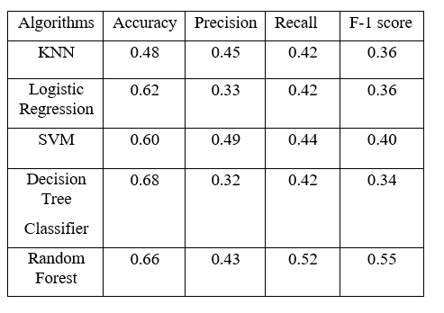
Models and Techniques
System use the c5.0 algorithm in order to predict the accurate result. In this section work on Five classifier including c5.0, KNN, Logistic Regression, Random Forest and SVM to calculate the model fitness and accuracy we used the dataset.

Slide 6
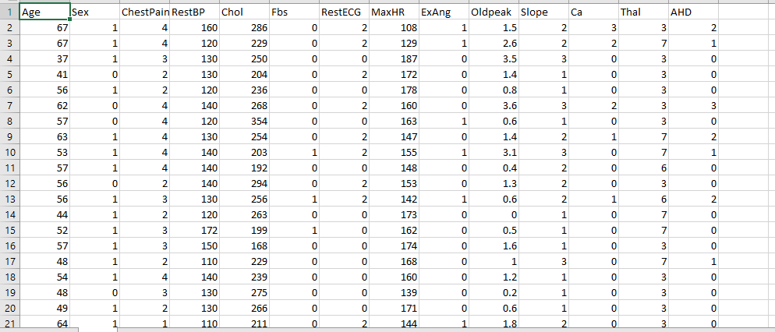
Experimental Setting
Software: Spyder, Anaconda, Google Colab
Tools : Weka Learning tool, Scikit Learn, Python 3.7.1
Dataset: Dataset from UCI repository

Slide 7
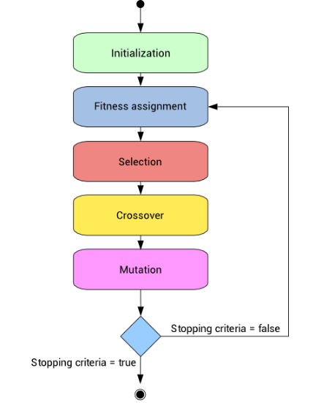
Algorithm
Feature selection through Genetic algorithm
The dataset with 14 features is taken for the study, each individual in the total population attributes is a predictive model. The genes represent total number of attributes in our dataset. The genes are numeric values taken in various ranges.
Initialization of Individuals
Assigning Fitness value
Operation selection
Crossover
5. Mutation

Slide 8
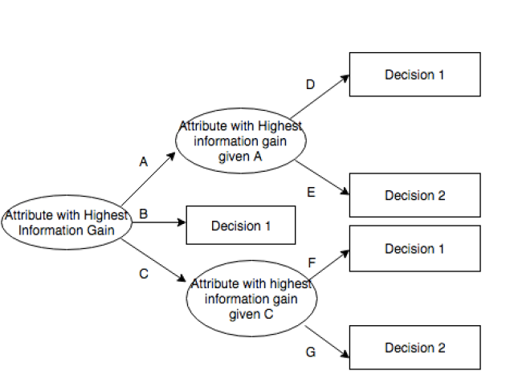
Algorithm
C 5.0 Algorithm
C 5.0 is the extension of ID3 algorithm, it works based on decision tree model for classification from input data samples. Divide and conquer is applied for each construction of tree, which is based on information gain from the attributes. There are three major steps involved in the decision tree.
The samples of same class in the dataset, then the leaf node is created for decision tree of same class
• If information gain is not available, the node is created high up the tree with expected class value.
• The class of unseen data is detected, the decision node is created again high up the tree with the expected class value.

Slide 9
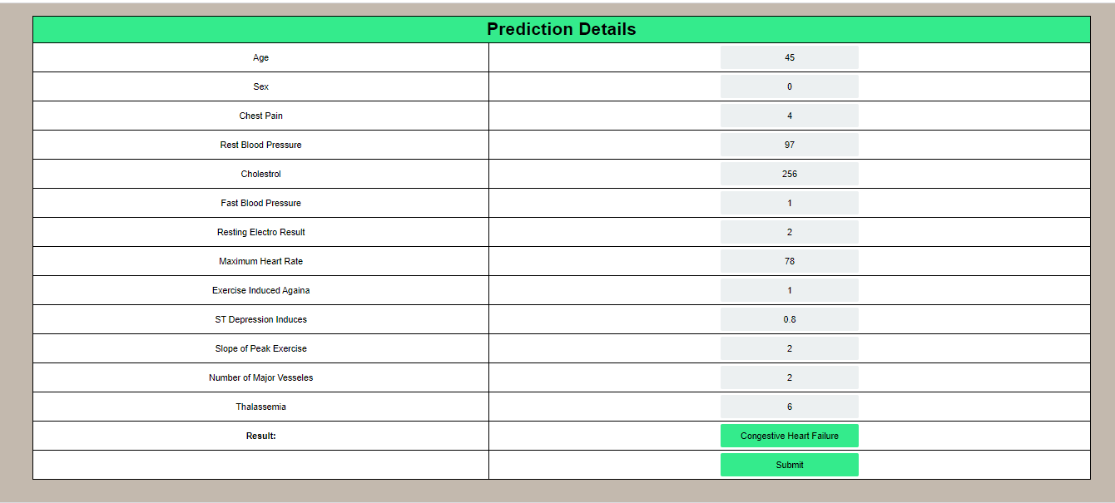
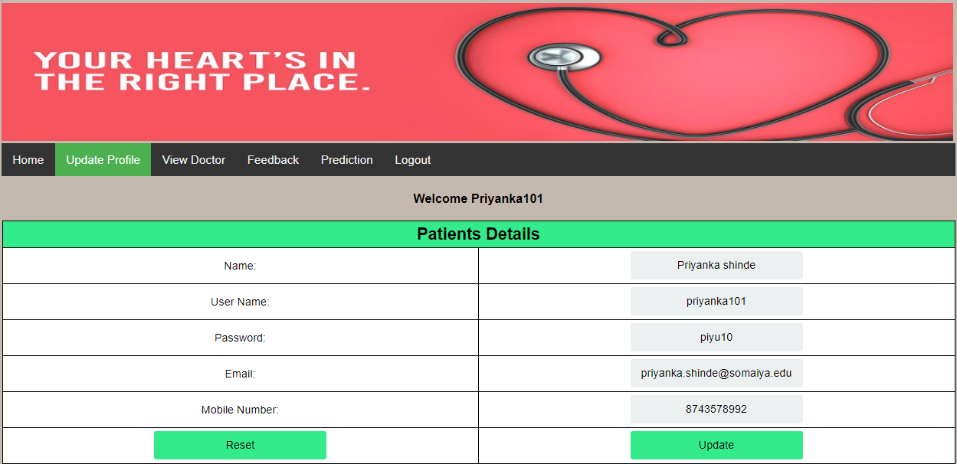
Results and Discussion
Prediction Disease
Prediction Details updating

Slide 10
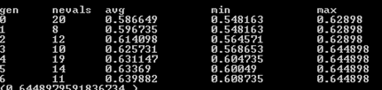

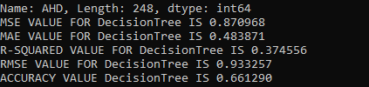
Results and Discussion
Score values given by GA
Features selected through GA
Heart Disease prediction through Decision Tree

Slide 11
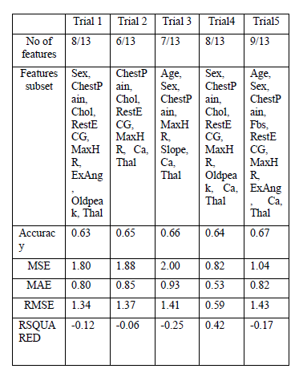
Evaluation of Result
The evaluation metrics calculated are accuracy, MSE (Mean square error), MAE (Mean Absolute error), R-Squared error and RMSE (Root Mean Square Error) are evaluated. Experimental evaluations shows that our ensemble model of Genetic algorithm feature selection and C5.0 out performs in detection of heart disease.
From the above Table 3 it shows trial 5 gives the most Accuracy which is 0.67 with mean squared error 1.04, mean absolute error 0.82, RMSE value 1.43 and R-squared value -0.17.

Slide 12
Conclusions
Heart disease or Cardiovascular disease one of the major threats with this growing life style, there are many clinical diagnoses are available. The earlier detection of the heart disease may save many human lives. Machine learning models are widely used for disease detection, whereas our proposed work considers the unique model for detection. In this work, we proposed Genetic algorithm-based feature selection and then C5.0 machine learning classification is applied for detection. The work also proposed with a Web interface, wherein patients and doctor able to communicate and get their benefits of early detection and treatment. This application detects heart disease as type 0 - Normal; 1- High Blood Pressure; 2- Coronary Artery Disease; 3- Congestive Heart Failure; 4- Stroke. Experimental results shows that the system outperforms in detection accuracy, even though considered as multi class problem.

Slide 13
Future Research
The system is developed based on genetic and classification algorithm.in purposed system dataset is limited. In future more advanced system can be developed which give more accurate result and less execution time. The future system will predict the result with more accurate result and less attribute. future system will be developed based on large dataset which gives more accurate and perfect prediction about diseases.

Slide 14
References
[1] Yekkala, Indu & Dixit, Sunanda. (2018). Prediction of Heart Disease Using Random Forest and Rough Set Based Feature Selection. International Journal of Big Data and Analytics in Healthcare. 3. 1-12. 10.4018/IJBDAH.2018010101.
[2] P K, Anooj. (2012). Clinical decision support system: Risk level prediction of heart disease using weighted fuzzy rules. Journal of King Saud University - Computer and Information Sciences. 24. 27-40. 10.1016/j.jksuci.2011.09.002.
[3] H. A. Esfahani and M. Ghazanfari, "Cardiovascular disease detection using a new ensemble classifier," 2017 IEEE 4th International Conference on Knowledge-Based Engineering and Innovation (KBEI), Tehran, Iran, 2017, pp. 1011-1014.
[4] Das, Resul & Turkoglu, Ibrahim & Sengur, Abdulkadir. (2009). Effective diagnosis of heart disease through neural networks ensembles. Expert Syst. Appl..36. 7675-7680. 10.1016/j.eswa.2008.09.013.
[5] J. S. Sonawane and D. R. Patil, "Prediction of heart disease using multilayer perceptron neural network," International Conference on Information Communication and Embedded Systems (ICICES2014), Chennai, India, 2014, pp. 1-6.
[6] M. Gandhi and S. N. Singh, "Predictions in heart disease using techniques of data mining," 2015 International Conference on Futuristic Trends on Computational Analysis and Knowledge Management (ABLAZE), Greater Noida, India, 2015, pp. 520-525.
[7] B. S. S. Rathnayakc and G. U. Ganegoda, "Heart Diseases Prediction with Data Mining and Neural Network Techniques," 2018 3rd International Conference for Convergence in Technology (I2CT), Pune, India, 2018, pp. 1-6.

Slide 15
Thank you

